Slide 1
Work Progress
By: Abdur Rehman

Slide 2
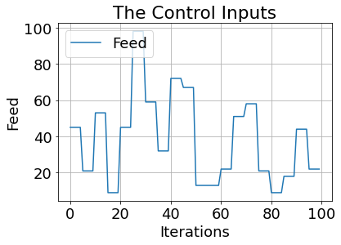
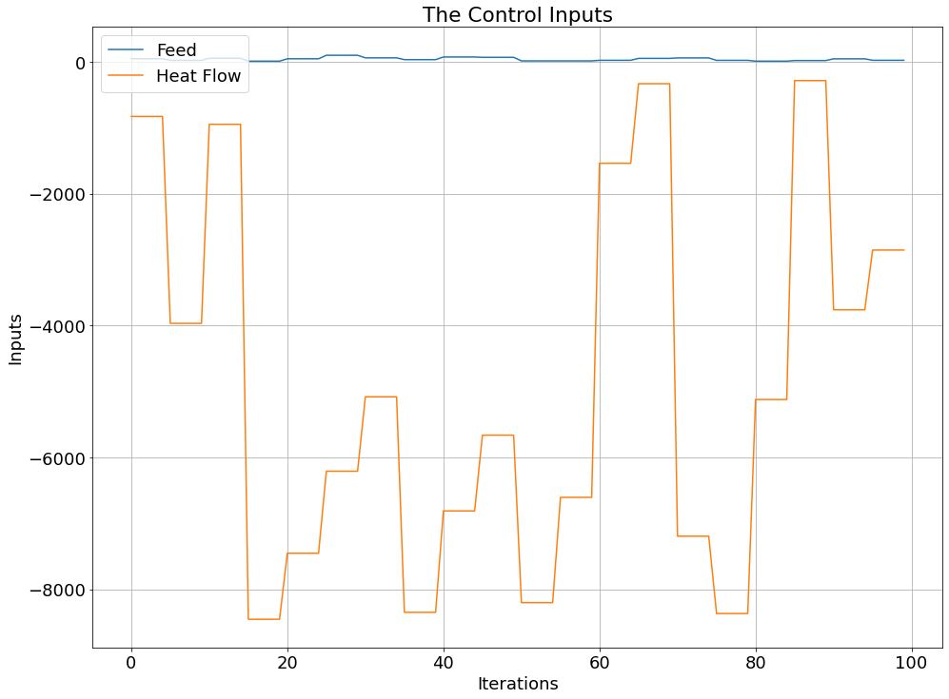
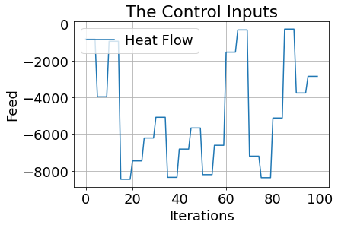

Visualizing the Inputs and Outputs
The control inputs are the feed F and the heat flow$\dot{ Q }$:

Slide 3
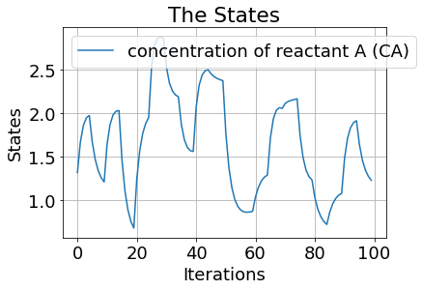
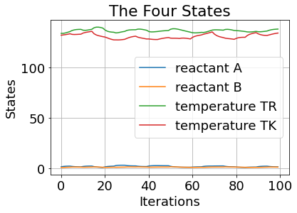
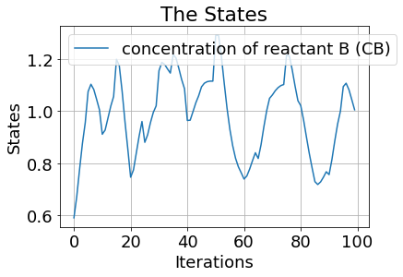
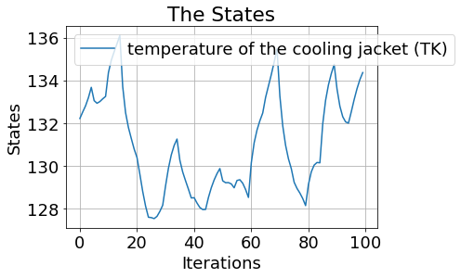
The four states are concentration of reactant A (CA), the concentration of reactant B (CB), the temperature inside the reactor (TR) and the temperature of the cooling jacket (TK):

Slide 4
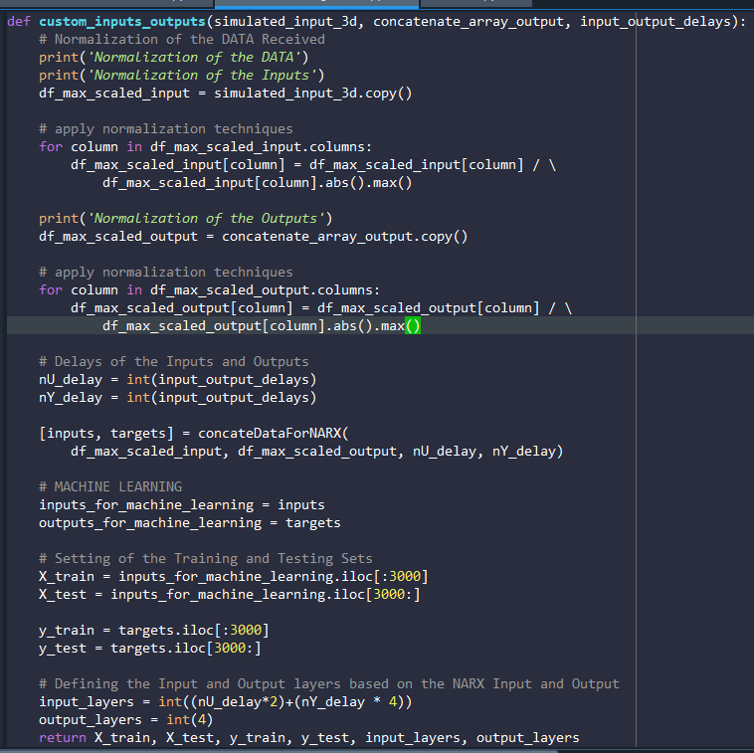
Custom Inputs and Outputs Function
The idea of this custom function is to take the random Input, used the Output generated from the DO_MPC simulator and assign the Input/Output Delays for the NARX Model and receive the Training, Testing, Input and Output Layers in the form of: X_train, X_test, y_train, y_test, input_layers, output_layers

Slide 5
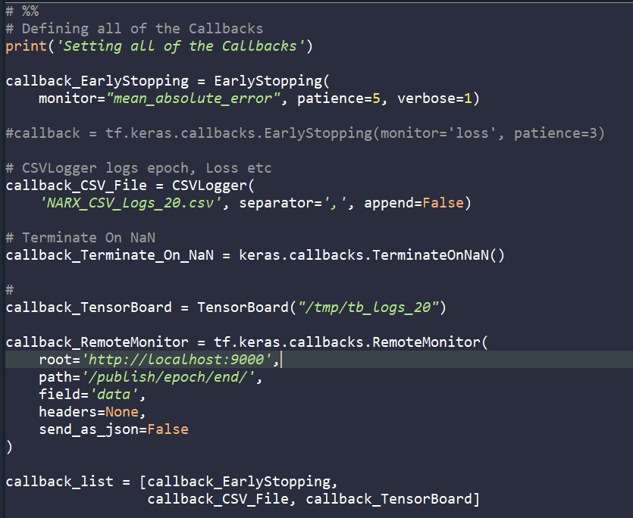
Callbacks
To efficiently used the Hyperparameter Tuning, callbacks come in handy. It can perform various tedious actions at various stages of the training.
Some of the Callbacks used are the following: EarlyStopping, CSVLogger, TerminateOnNaN, TensorBoard

Slide 6
Keras-Tuner: Hyperparameter Optimization Framework
Tune The Model Architecture:
The first thing we need to do is writing a function, which returns a compiled Keras model. It takes an argument hp for defining the hyperparameters while building the model.
The parameters expected to be tuned:
Delay Size in the Input and the Output
input_delay_size = hp.Int("input_delay_size", 2, 20, step=1)
Number Of Hidden Layers
range(hp.Int('hidden_layers', 2, 25))
Number Of Neurons
units=hp.Int('units_nodes_' + str(i), min_value=32, max_value=256, step=8)
Activation Functions
activations=hp.Choice('activation_', ["relu", "tanh", "sigmoid"])
activation=activations
Learning Rate
hp.Choice('learning_rate', [1e-1, 1e-2])
Optimizers Used ADAM:
optimizer=tf.keras.optimizers.Adam
Metrices Considered:
metrics=['mean_squared_error', 'mean_absolute_error', 'mean_absolute_percentage_error’, tf.keras.metrics.RootMeanSquaredError()]
Loss: 'mean_absolute_error'

Slide 7
Results 1:
tuner.results_summary()
Best mean_absolute_error So Far: 0.017436451092362405
Total elapsed time: 00h 09m 41s
best_hp.values
{'input_delay_size': 16, 'activation_': 'relu', 'hidden_layers': 2, 'units_nodes_0': 72, 'units_nodes_1': 184, 'learning_rate': 0.01, 'units_nodes_2': 136, 'units_nodes_3': 104, 'units_nodes_4': 136, 'units_nodes_5': 120, 'shuffle': True, 'units_nodes_6': 88, 'units_nodes_7': 256, 'units_nodes_8': 216, 'units_nodes_9': 80, 'units_nodes_10': 40, 'units_nodes_11': 256, 'units_nodes_12': 216, 'units_nodes_13': 120, 'units_nodes_14': 216, 'units_nodes_15': 88, 'units_nodes_16': 192, 'units_nodes_17': 64, 'units_nodes_18': 232, 'units_nodes_19': 144, 'units_nodes_20': 216}
History TEST
loss | 0.014079165644943714
mean_absolute_error | 014079165644943714
mean_squared_error | 0.0011004337575286627
root_mean_squared_error | 0.033172786235809326
History TRAIN
loss | 0.0131768099963665
mean_absolute_error | 0.0131768099963665
mean_squared_error | 0.0009960528695955873
root_mean_squared_error | 0.03156030550599098

Slide 8
Model: "sequential_1"
_________________________________________________________________
Layer (type) Output Shape Param #
=================================================================
flatten_1 (Flatten) (None, 96) 0
dense_5 (Dense) (None, 72) 6984
dense_6 (Dense) (None, 184) 13432
dense_7 (Dense) (None, 4) 740
=================================================================
Total params: 21,156
Trainable params: 21,156
Non-trainable params: 0
_________________________________________________________________

Slide 9
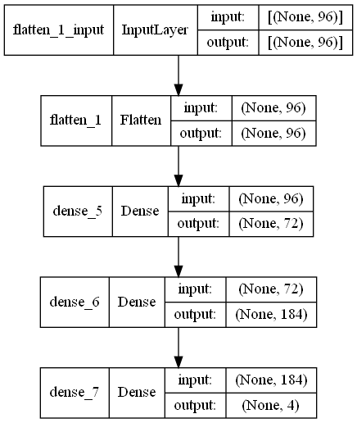

Slide 10
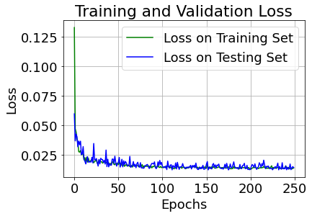
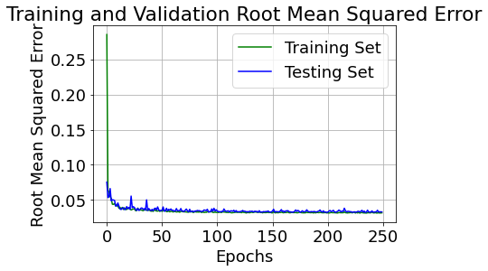

Slide 11
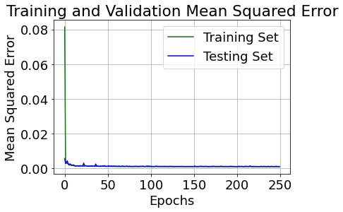
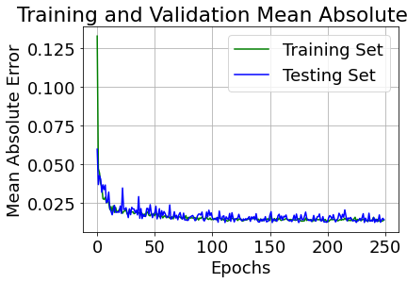

Slide 12
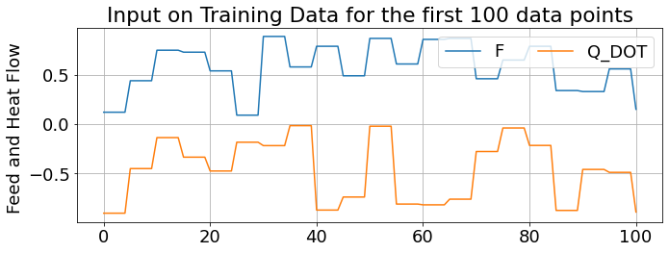
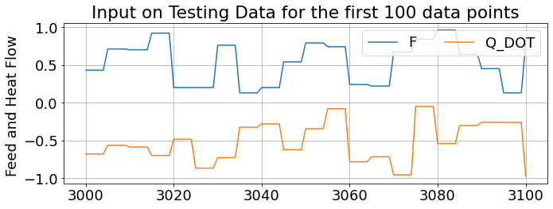

Slide 13
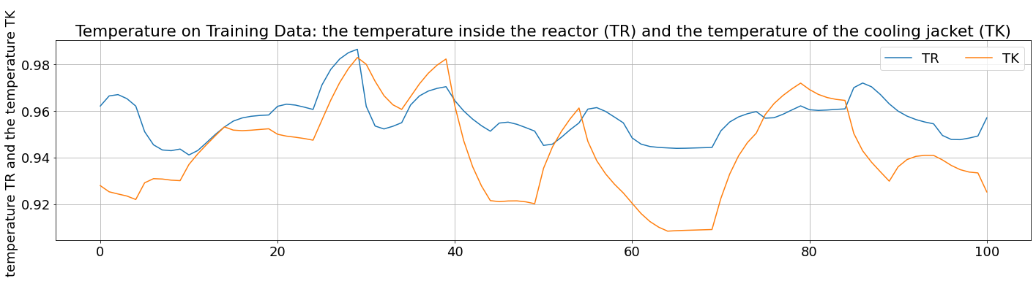
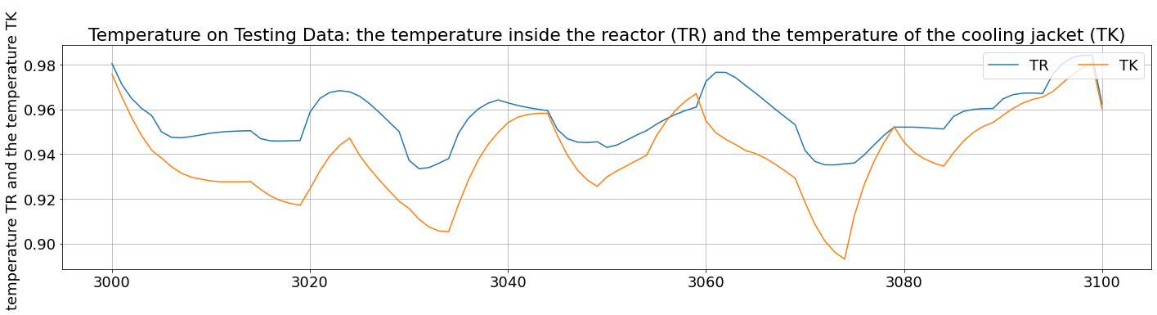

Slide 14
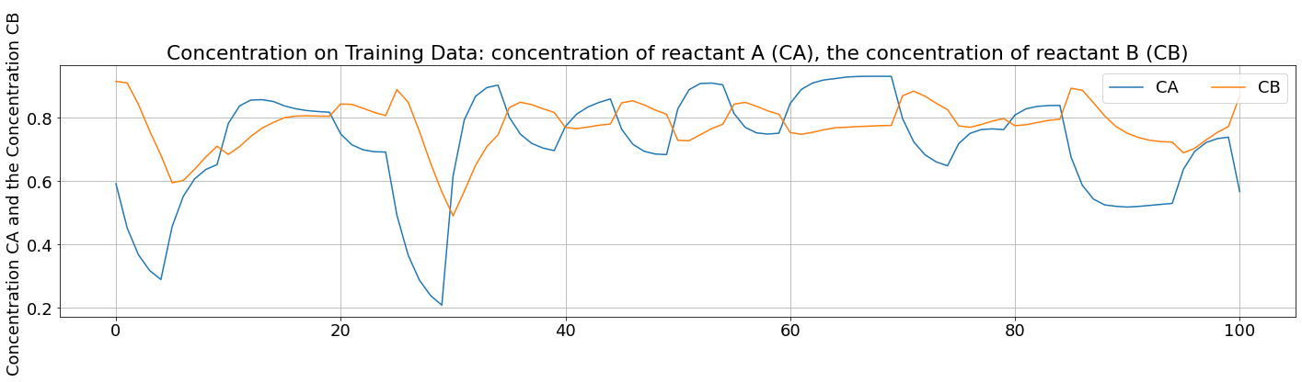
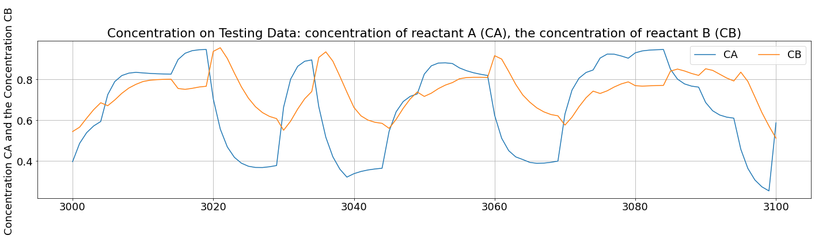

Slide 15
CLOSED LOOP SIMULATION

Slide 16
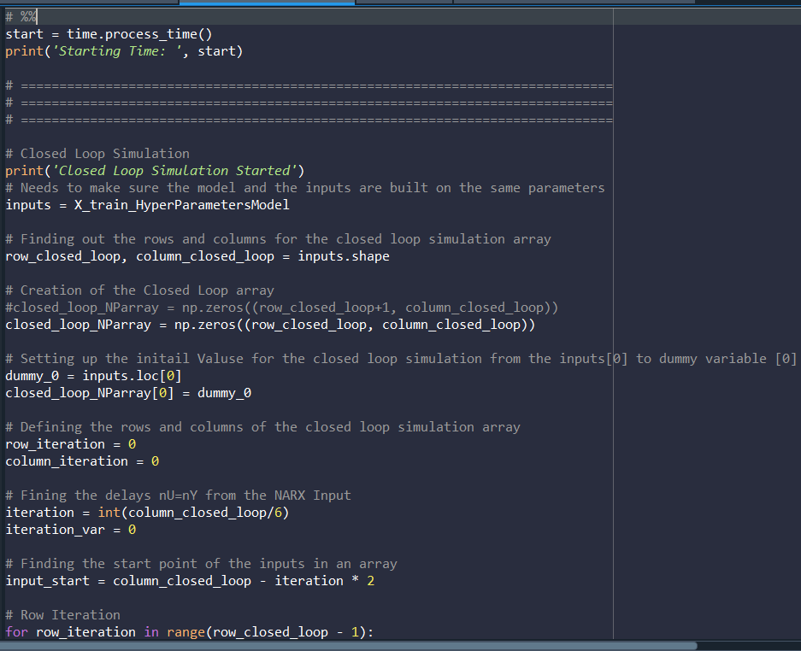
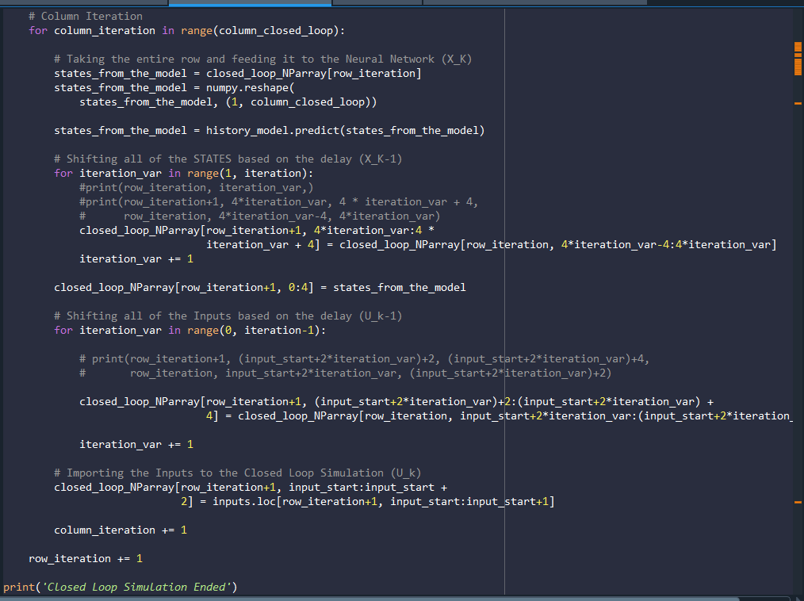

Slide 17
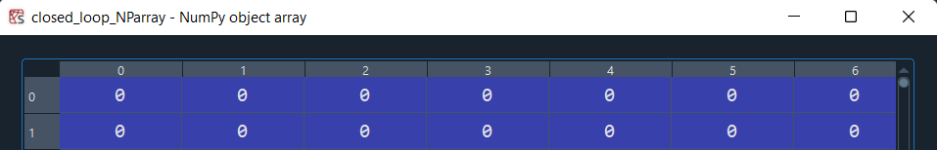
DEMONSTRATION
STEP I: Creation of a Dummy Array to feed the Input and run the Closed Loop Simulation
Needs to make sure the model and the inputs are built on the same parameters
inputs = X_train_HyperParametersModel
Finding out the rows and columns for the closed loop simulation array
row_closed_loop, column_closed_loop = inputs.shape
Creation of the Closed Loop array
closed_loop_NParray = np.zeros((row_closed_loop, column_closed_loop))
Setting up the initail Valuse for the closed loop simulation from the inputs[0] to dummy variable [0]
dummy_0 = inputs.loc[0]
closed_loop_NParray[0] = dummy_0
STEP II: Take the entire row and feed it to the Neural Network (X_K)

Slide 18
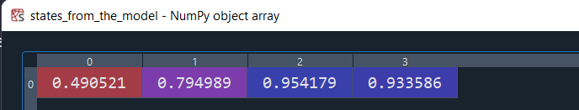
STEP III: Taking the entire row and feeding it to the Neural Network (X_K)
states_from_the_model = history_model.predict(states_from_the_model)
STEP IV: Taking the entire row and feeding it to the Neural Network (X_K)
Shifting all of the STATES based on the delay (X_K-1)
Completing the Entire row and shifting it to the next row …

Slide 19
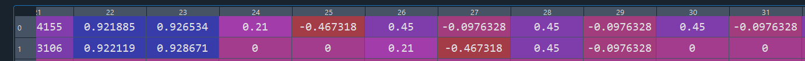
STEP V: Using the Neural Network Model, assigning the first row to the model and fitting it in the second row
STEP VI: Repeating the shifting procedure for the Inputs
STEP VII: Inserting the New Input from the Simulated Data

